Slide 1
Introduktion til Programmering og Problemløsning (PoP)
Jon Sporring
Department of Computer Science
2022/09/02

Slide 2
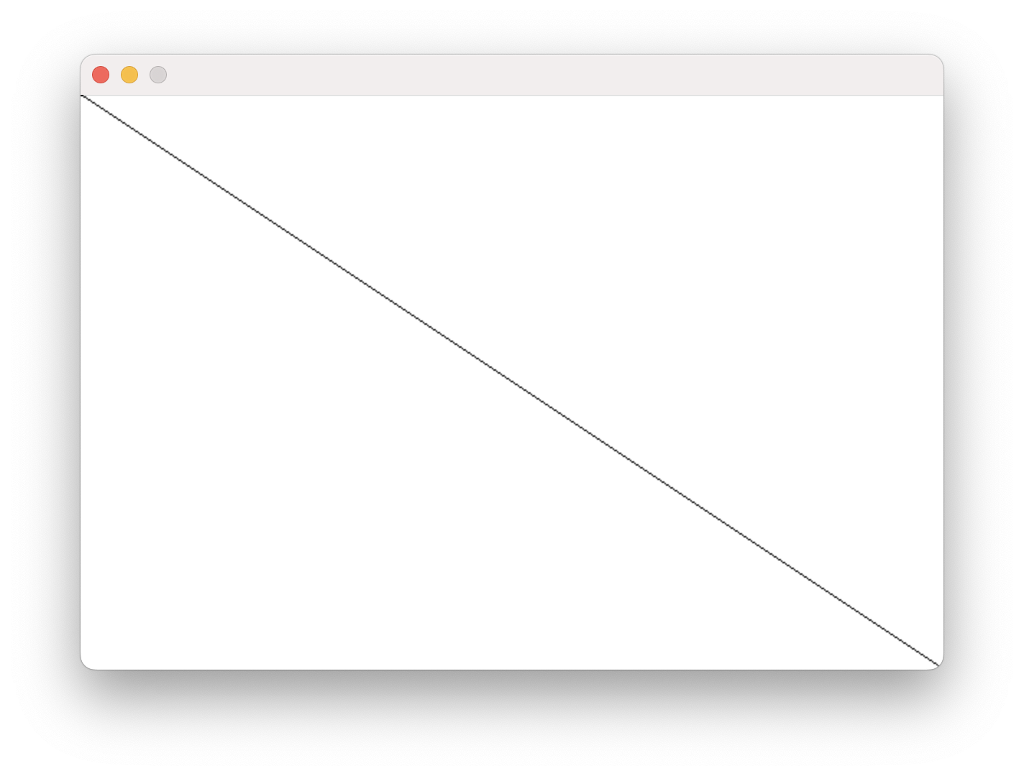
Canvas
#r "nuget:DIKU.Canvas, 1.0"
open Canvas
let w = 600;
let h = 400;
let C = create w h
do setLine C black (0,0) (w-1,h-1)
do show C "My First Canvas"

Slide 3
Canvas
fromRgb : int * int * int -> color
fromArgb : int * int * int * int -> color
fromColor : color -> int * int * int * int
red, blue, green, yellow, lightgrey, white, black
create : int -> int -> canvas
setPixel : canvas -> color -> int * int -> unit
getPixel : canvas -> int * int -> color
setLine : canvas -> color -> int * int -> int * int -> unit
setBox : canvas -> color -> int * int -> int * int -> unit
setFillBox : canvas -> color -> int * int -> int * int -> unit
show : canvas -> string -> unit
Colors:
Predefined:
Functions:
width
x
height
y

Slide 4
#r "nuget:DIKU.Canvas, 1.0"
open Canvas
type state = int
let draw w h (s:state) =
let C = create w h
let left = w / 4
let right = 3*left
do setFillBox C blue (left+s, left) (right+s,right)
C
let react (s:state) (k:key) : state option =
match getKey k with
LeftArrow -> Some (s-5)
| RightArrow -> Some (s + 5)
| _ -> None
do runApp "ColorBoxes" 600 600 draw react 0
Canvas
Interactive Canvas
val runApp : string -> int -> int
-> (int -> int -> 's -> canvas)
-> ('s -> key -> 's option)
-> 's -> unit
// runApp sketch
let runApp txt w h drawFct reactFct initState =
let mutable s = initState
draw w h s
while true do
let k = userKeyPress () // waits for user to press key
s <- react s k
draw w h s

Slide 5
Resumé
Denne video fortalte om:
Hvordan man bruger Canvas biblioteket til at lave simpel grafik
Hvordan man kan interagere med runApp funktionen vha. tastaturet

